Slide 1
High School Athletics
Coleen davenport Paysinger mCAA, ATC
Athletic Director

Slide 2
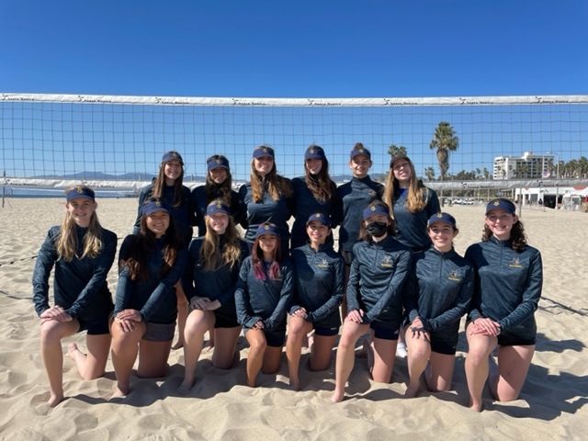
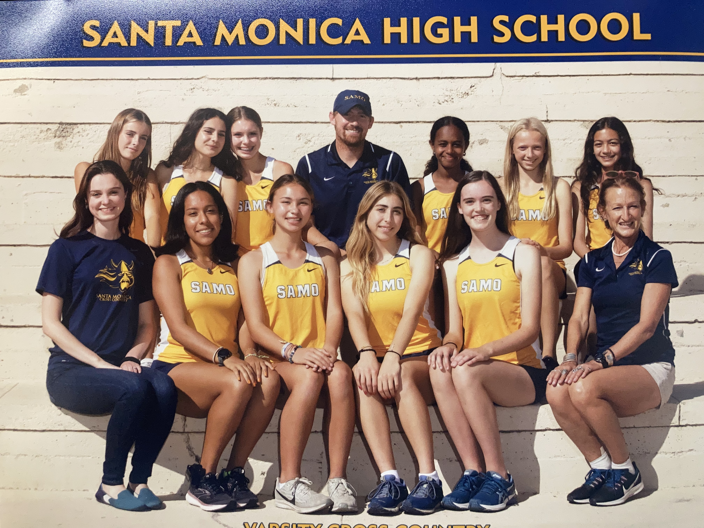
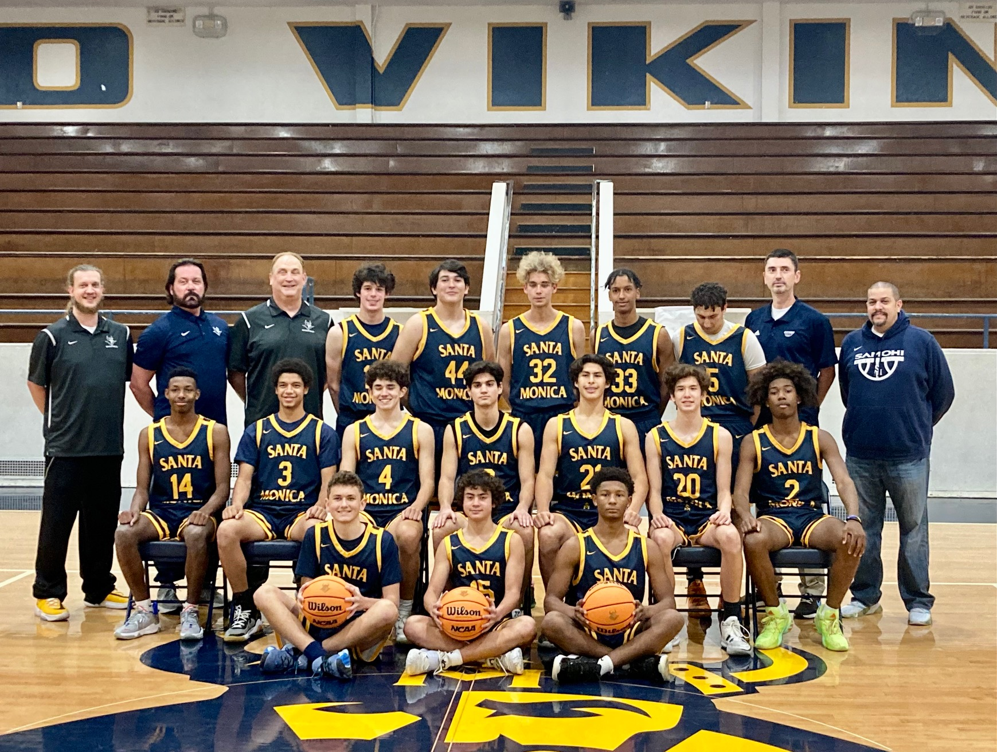
Santa Monica High School Athletics 2023-2024
CIF Sponsored sports fall into three season categories:
FALL: B&G Cross Country, Football, B Water Polo, G Golf, G Volleyball, G Tennis, *G Flag Football, Sideline Cheer & Pom
WINTER: B&G Soccer, B&G Basketball, B&G Wrestling, G Water polo, Sideline Cheer & Pom
SPRING: B Tennis, B Golf, B Volleyball, G Beach Volleyball, Baseball, Softball, B&G Track, B&G Swim, B&G Lacrosse, *Competitive Cheer
30 Competitive Varsity level sports
38 Competitive Lower level teams

Slide 3
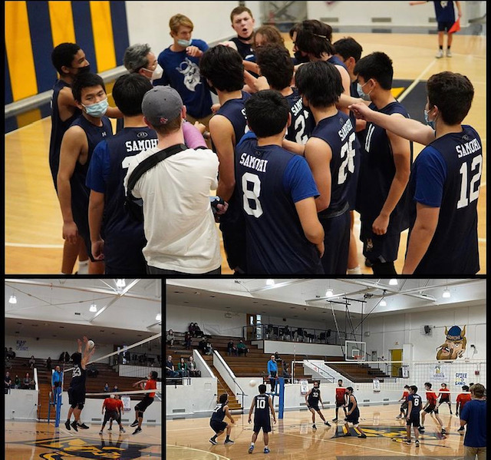
Educational Based Competitive Athletics
GOALS vs. PURPOSE
The GOAL of Educational based competitive athletics is to WIN with character and pride as school based teams within CIF-SS
The PURPOSE of Educational competitive athletics is the intentional, purposeful and consistent time and energy devoted to the full development of a student athlete that will benefit them on & off the field and throughout their future.
Santa Monica High school Athletic department mission statement: Our highly competitive athletic programs are dedicated to fostering a positive and healthy culture, which centers around respect, sportsmanship, commitment to inclusiveness and diversity, hard work, self-discipline, humility, and social and emotional growth.

Slide 4
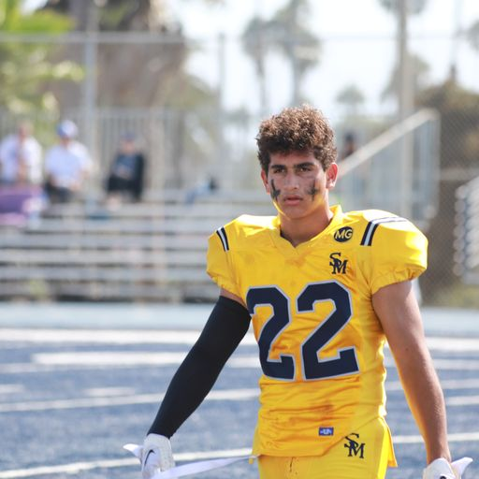
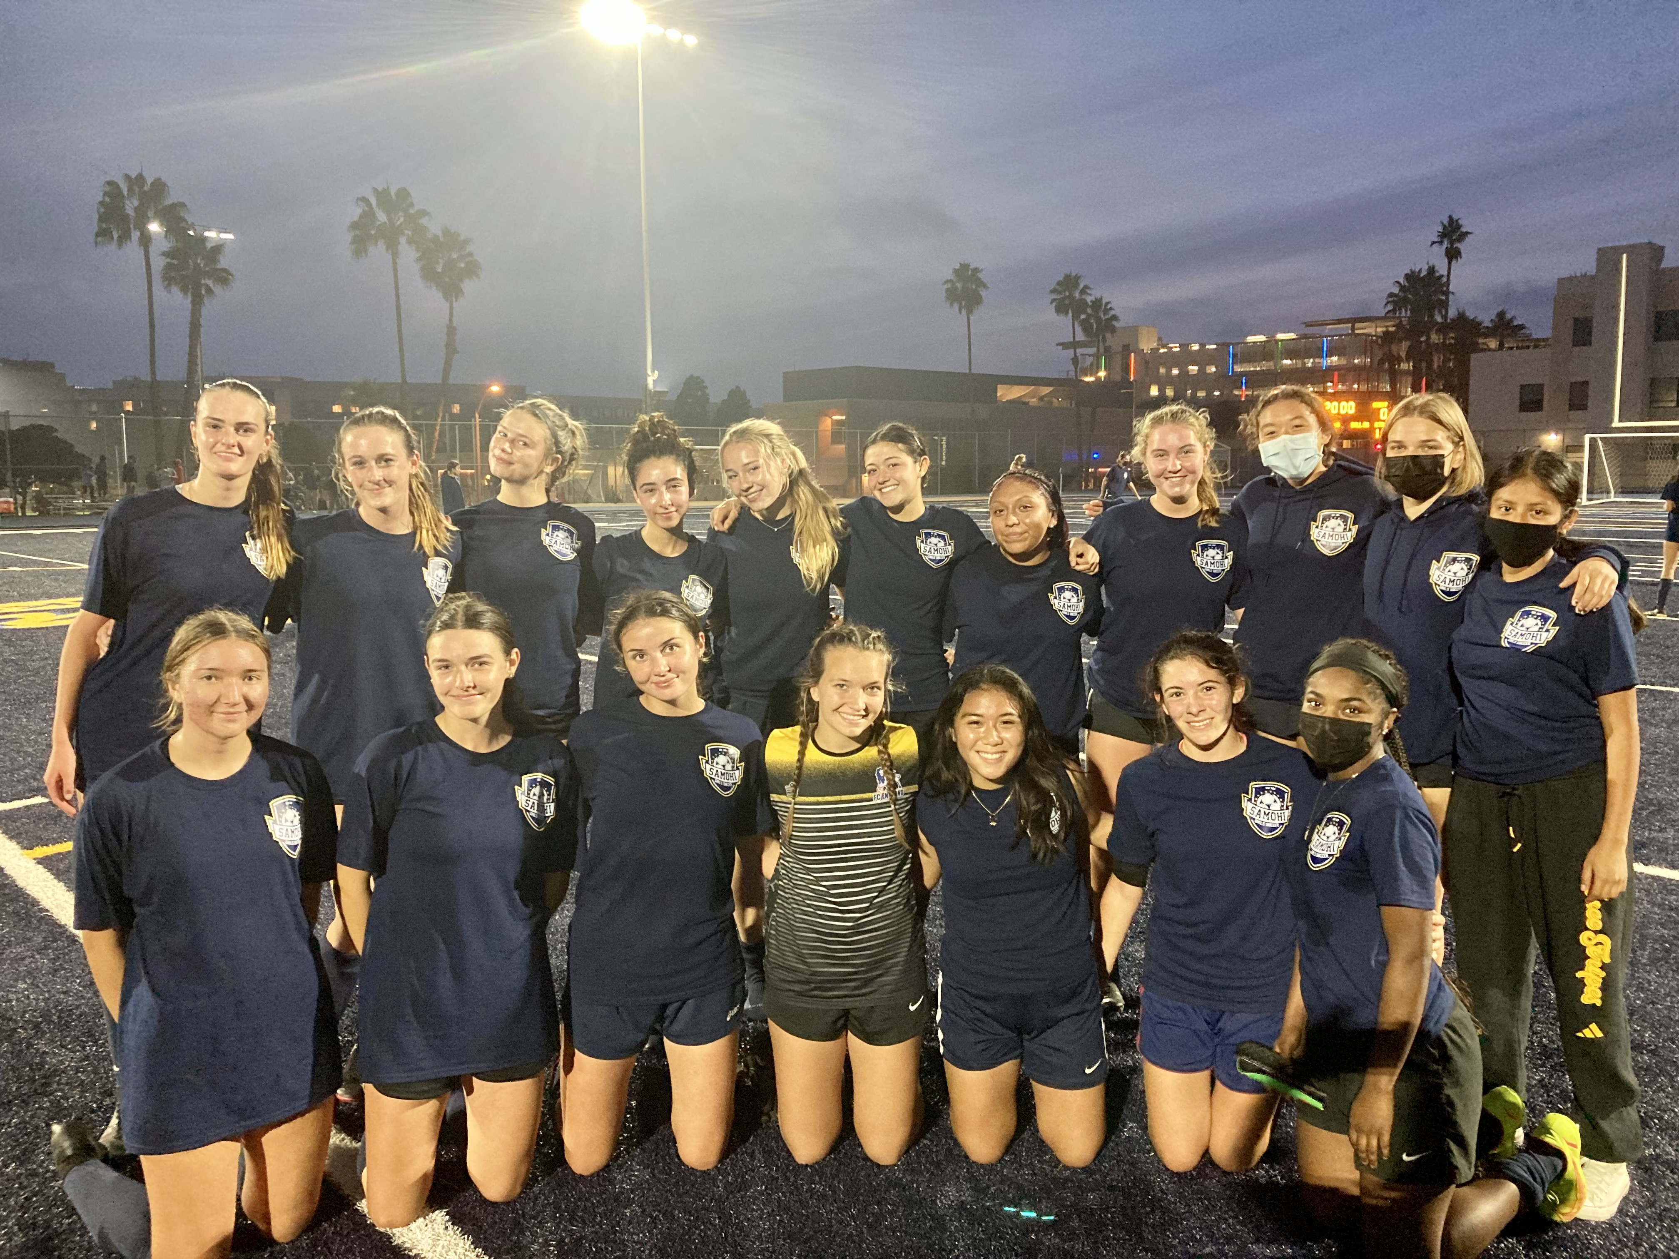
Why Educational Based Competitive Athletics?
Competitive athletics are a privilege- not a right. Every roster spot is earned and must be repetitively earned. That repetition of earning your place in a program builds character, tenacity and work ethic.
Growth Mindset “Growth and comfort do not coexist” Student athletes will be uncomfortable, tired, pushed to the limit- much like the real world demands of adult professionals. Greatness is not achieved in comfort without hard work, sweat and sacrifice.
Competitive drive, our athletes will learn that competitive drive takes intentional work, focus and goal setting, and the desire to succeed as a teammate, not as an individual.
Time management, Student athletes learn the essential skill of
time management, responsibility and life balance.

Slide 5
Basic CIF Requirements for Member Schools (cifss.org)
Student Eligibility Check list: including GPA, Progress towards graduation, minimum units per semester, school enrollment, transfers, recruiting violations
Association Fees: Each Member school pays a fee for every sport they participate to the local league, to CIFSS and to CIF State Association
CIF Bylaws BLUE BOOK contains the rules that govern all schools and all student athletes including, practice time limits, in season Sunday no contact, transfers, sport by sport game rules, playoff rules & divisions, spectator ejections, misconduct violations
League Associations: South Bay Athletic Association includes 19 area schools that agree to a set of bylaws and rules governing our league and games.

Slide 6
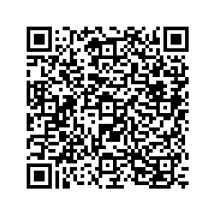
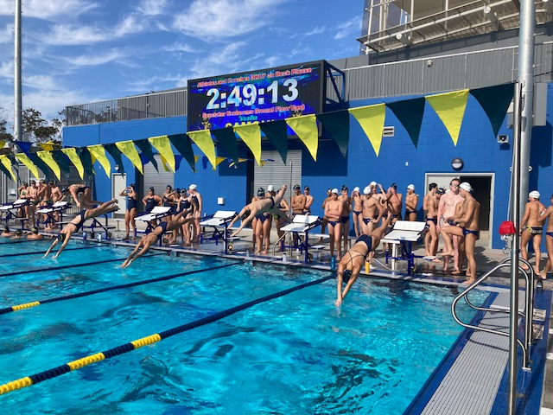
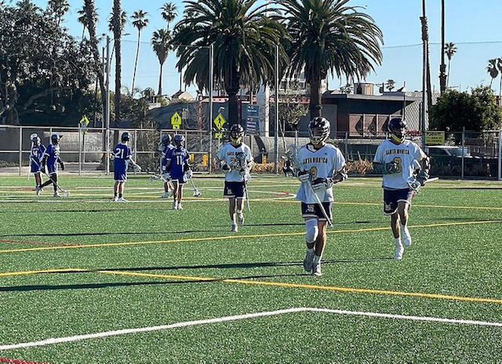
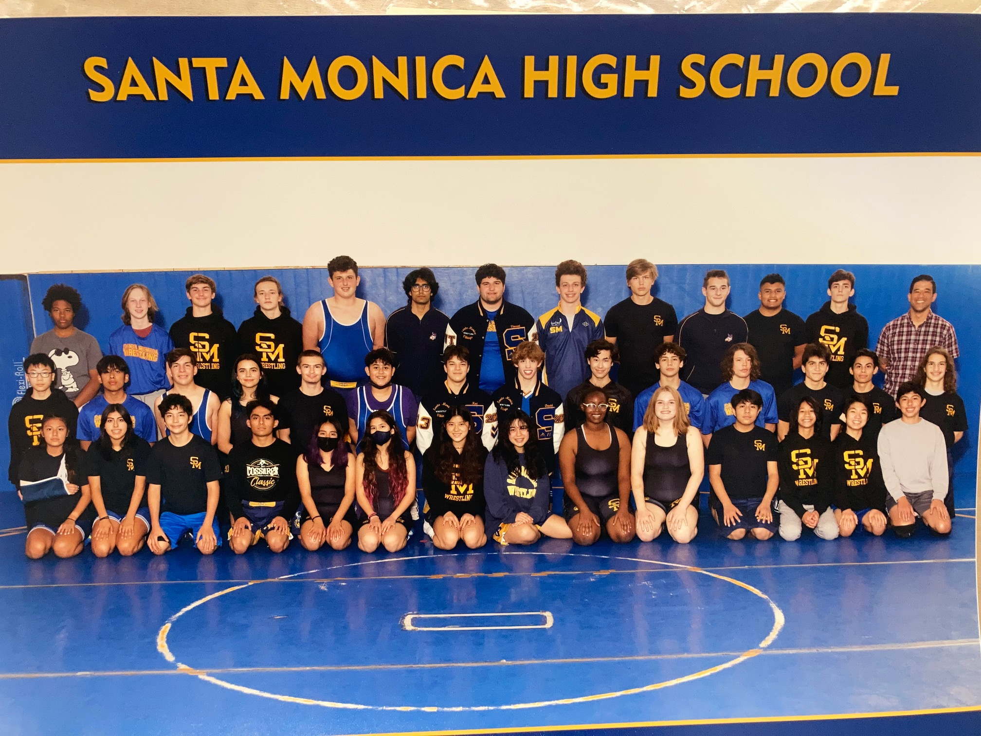
2023-24 TRYOUT PROCESS June 12-17th
Each program will hold OPEN tryouts during the week of June 12-17th
Tryouts are staggered so that multisport athletes have the opportunity to participate in multiple sports
Tryouts for incoming 9th grade athletes MUST occur after the last day of school in 8th grade (cheerleading is the exception)
All students participating in tryouts must have the following items:
Current Physical Exam
Proof of Medical insurance

Slide 8
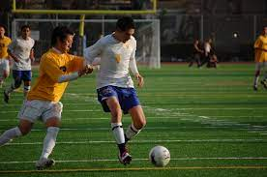
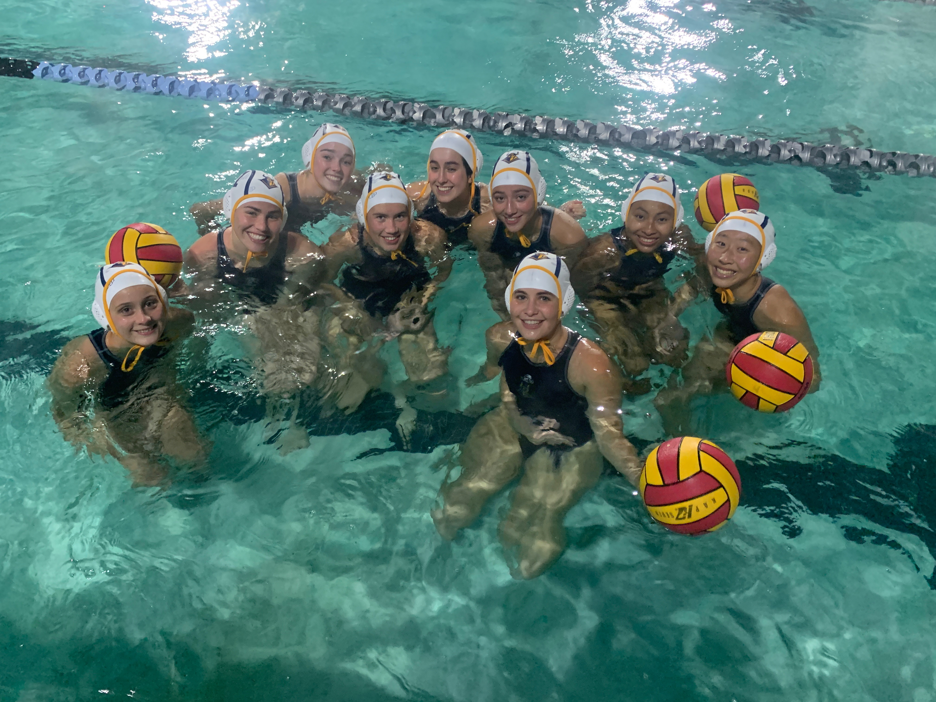
Typical Practice schedules for high school teams
Most athletic teams are scheduled during either period 6 or period 7
Student athletes earn PE credit for the year while they are enrolled in that period 6 or 7 class
Typical IN SEASON practice for most teams is scheduled between beginning of period 6 and 5:00pm
Typical OUT OF SEASON practice is limited to period 6 or 7 only.
Student athletes are required to participate in class that they are enrolled- even if they are on a club team outside of school
Student athletes are required to be enrolled in a class of the team that they are competing. Multi sport athletes will move from class to class as the seasons change.
Some teams practice at off site locations including Memorial Park, JAMS and Belmar park

Slide 9
Anticipated yearly costs for Athletics programs
Bus and Van Transportation for teams ~ $225,000.00
CIF approved game balls/ approved game equipment ~ $40,000.00
Uniforms ~ $40,000.00
CIF State, Southern Section and League Dues ~ $10,000.00
Facility upkeep/ repair and management ~ $35,000.00
Sports medicine and safety equipment ~ $18,000.00
Athletic Department Staff Full time/ Part time ~ $180,000.00
Coaches stipends (85+ Coaches) ~ $225,000.00
Individual team expenses-tournaments, training gear, Practice wear, Banquet/ awards, etc. ~ $100,000.00
Game officials for all 68 Teams Home Games ~ $55,000.00

Slide 10
2022-23 School year Accomplishments
Girls Cross Country team advances to STATE CIF meet for the first time in school history
Girls Wrestling Team earned the CIFSS TOP All Academic team award
Football team plays first games at Home, on campus in decades
Girls Volleyball Team earns CIF playoff bid out of the toughest league in Southern California
Boys and Girls Basketball play multiple CIF playoff games in their respective divisions
Boys Soccer earns CIFSS Semi-Finals & CIF Southern Cal Regional Playoffs in Division 2
Girls Soccer plays multiple games in Division 2 CIF playoffs
Wrestling has 6 individual wrestlers earn a place to compete at the Masters meet and one individual competed and finished 3rd at State meet.
Our current 10 spring sports are all on target to compete in CIF playoffs later this spring.

Slide 11
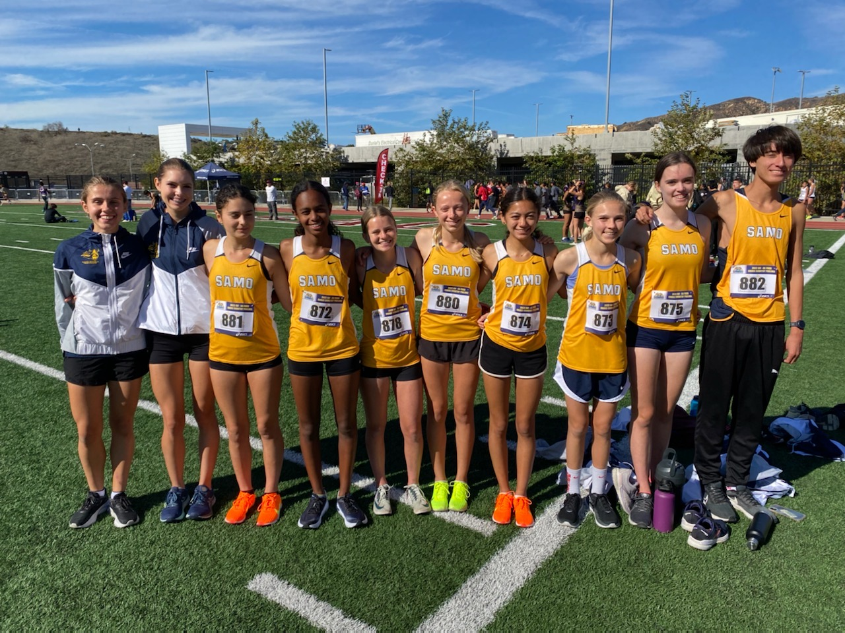
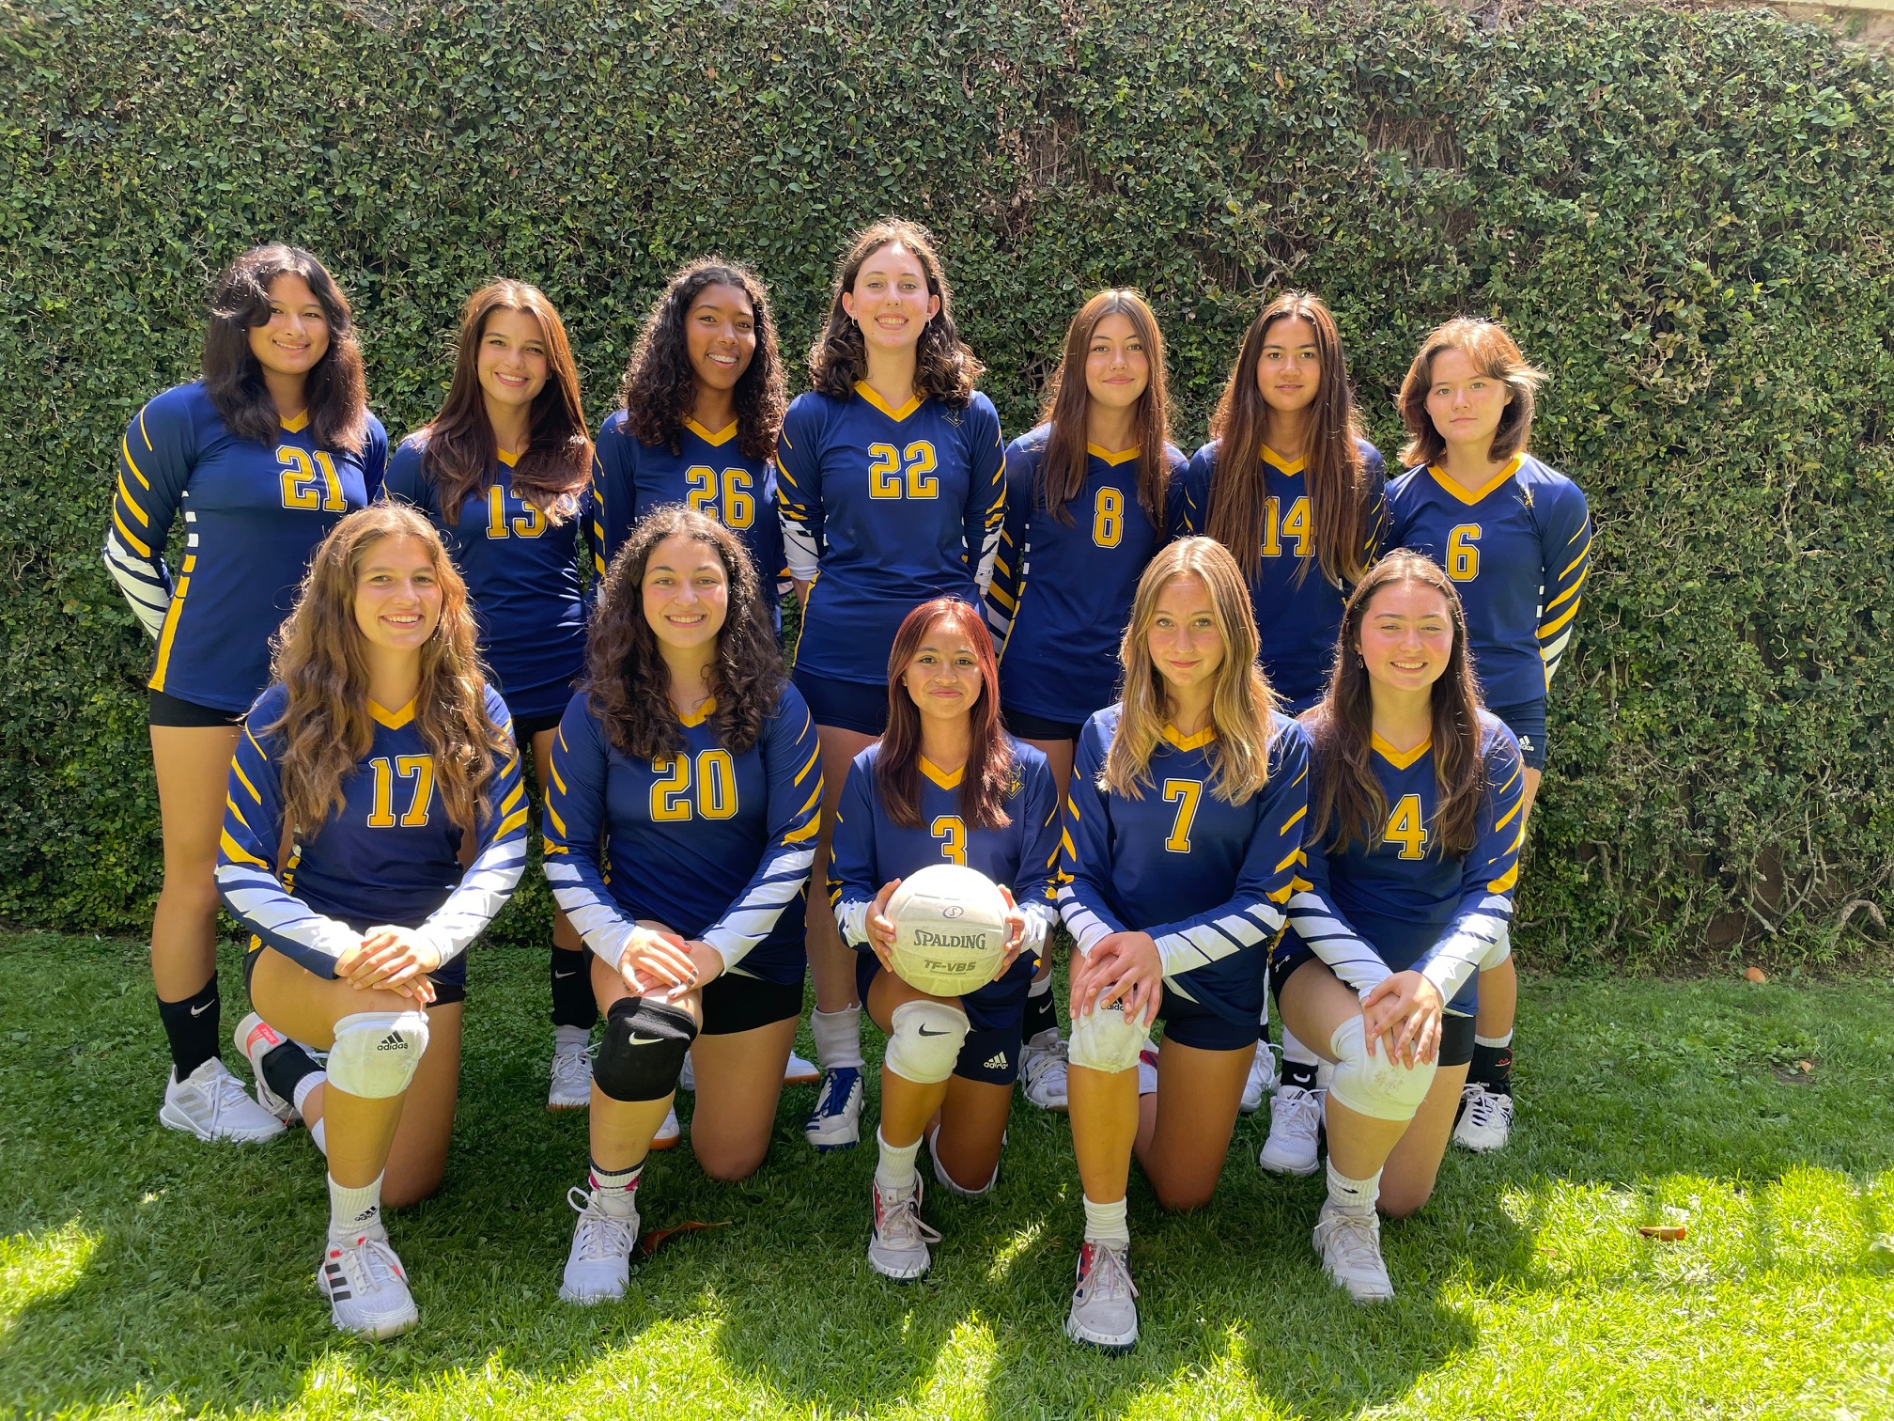
High School Athletics FAQ Conclusion
HOW MANY SPORTS CAN A STUDENT PLAY IN THE YEAR?
All students enrolled at SAMOHI are encouraged to participate in multiple sports per year. Students are allowed to participate on one sport for each of the three seasons.
WHERE ARE ALL THE SPORTS GAMES SCHEDULES FOUND?
All of the sports have a page on the Samohi website. On that team page the games of the season are listed with other important information for that sport
HOW CAN WE SUPPORT OUR STUDENT ATHLETE AND SPORTS TEAM?
Parents are the largest personal support for each of our teams. Attend games as a positive spectator, purchase ASB card for student athlete, support the team concept, volunteer at snack stands, or banquets. Donate to ED FOUNDATION

Slide 12
THANK YOU and have a great night.
Contact: Coleen Davenport Paysinger
cdavenport@smmusd.org

